Slide 1
Sentiment Analysis and Predictions on Twitter Reviews
Sevi Yfanti - 1994
Vasilis Zaridis - 2013
Panagiotis Grigoriadis - 1833

Slide 2
Chapters
Dataset
Preprocessing
Data Analysis
Natural Language Processing
Predictions
ML algorithms
Neural Networks
Conclusion

Slide 3
The problem
Airline companies don’t have a lot of feedback considering the credibility of their services.
Twitter is a major source of information
However, text format needs process in order to be useful

Slide 4
Goal
Extract information from tweets and other attributes
Provide insight about the quality of the airline’s services

Slide 5
Team goals
Get familiar with Natural Language Processing
Practice classic machine learning techniques learned during the semester
Experiment on Neural Networks

Slide 6
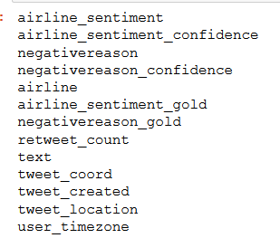
Dataset
Downloaded dataset from Kaggle competition
Attributes:
Especially interested on ‘text’ attribute

Slide 7
Preprocessing
Drop useless variables
Drop columns with high correlation
Handle missing values ( replace Nan values with column’s average )
Handle categorical variables ( One-Hot encoding )

Slide 8
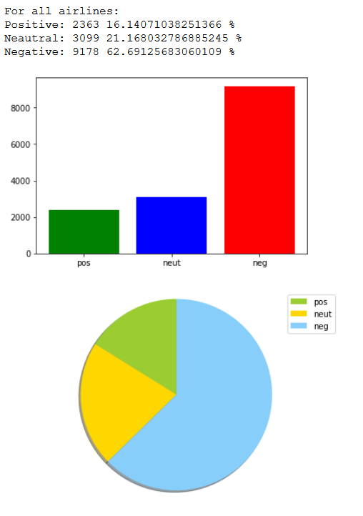
Analysis (1) Sentiment Percentages

Slide 9
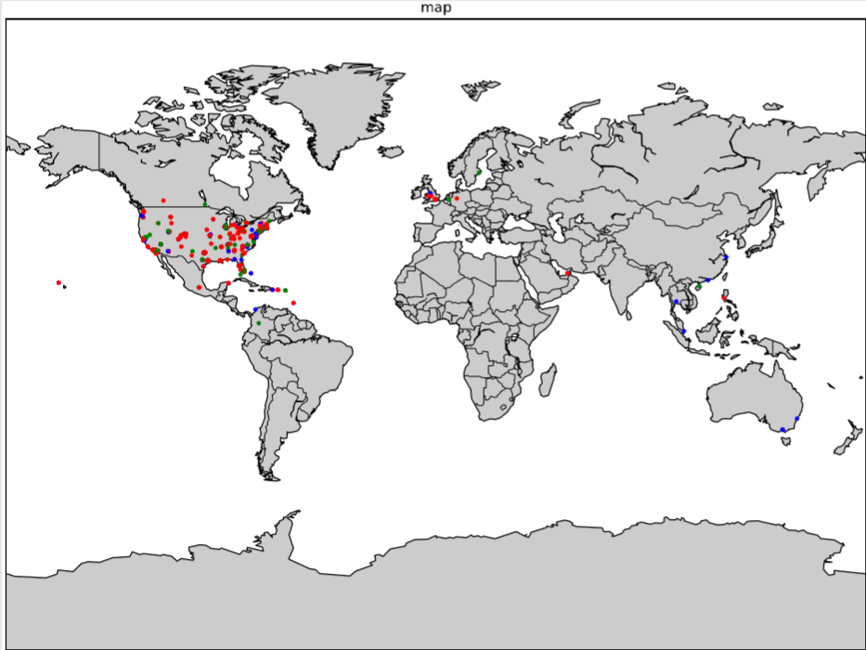
Analysis (5) Maping tweets on world map

Slide 10
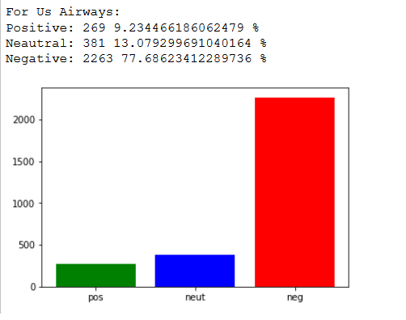
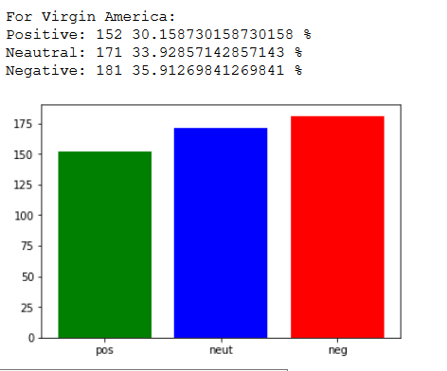
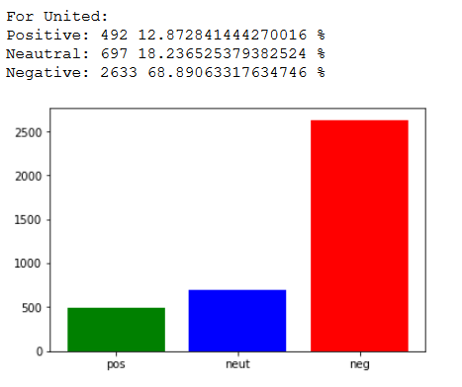
Analysis (2) Negative reviews on each company

Slide 11
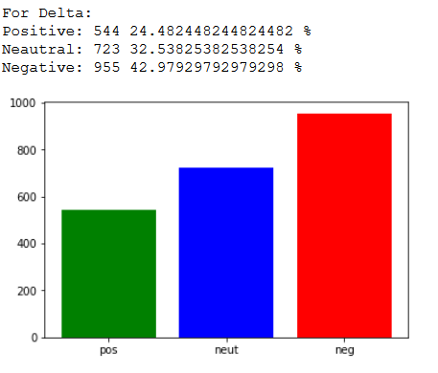
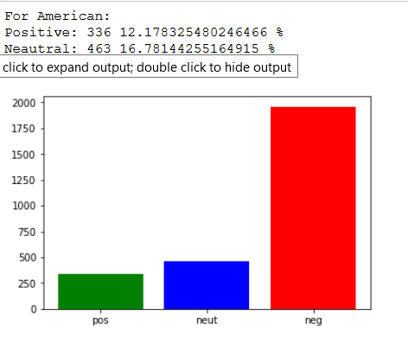
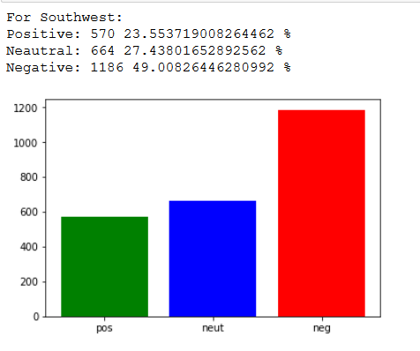

Slide 12
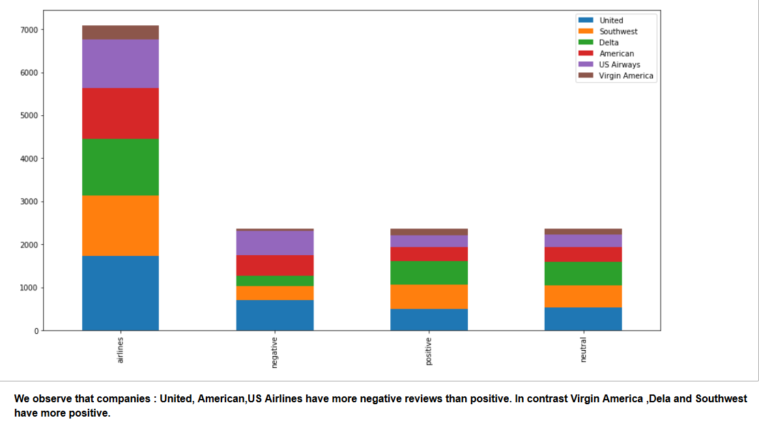
Analysis (3) Negative reviews on each company

Slide 13
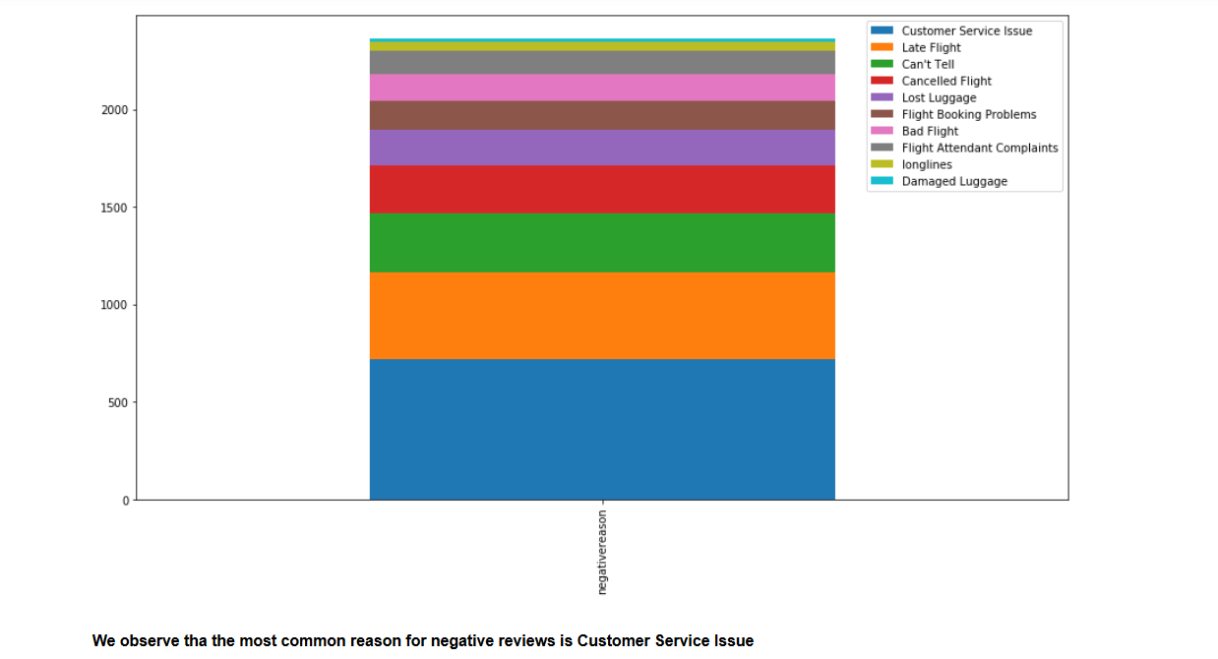
Analysis (4) Negative reasons

Slide 14
Natural Language Processing
The process of programming computers to process and analyze large amounts of natural language data
Essentially, converting text into vectors of real numbers.

Slide 15
Natural Language Processing (1)
Removal of Twitter Handles (@user)
Removal of Punctuations, Numbers, and Special Characters
Removal of Stop Words, Short Words and Rare words
Lower case transformation

Slide 16
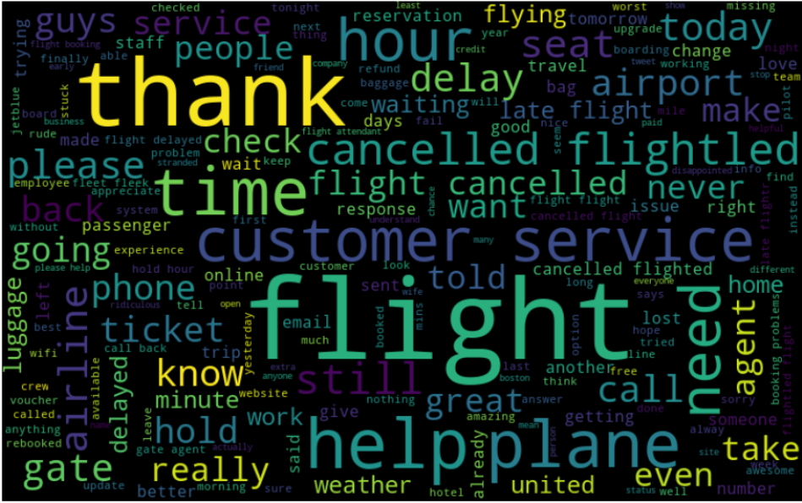
WordCloud All Sentiments

Slide 17
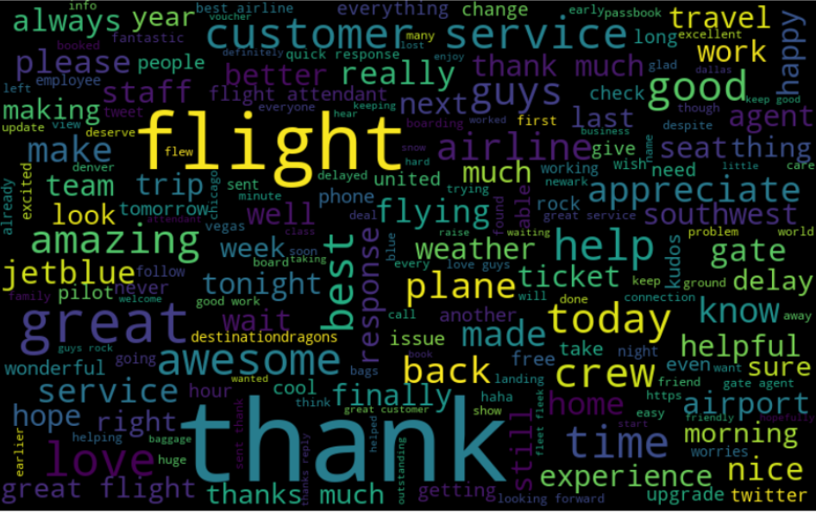
WordCloud Positive Sentiment

Slide 18
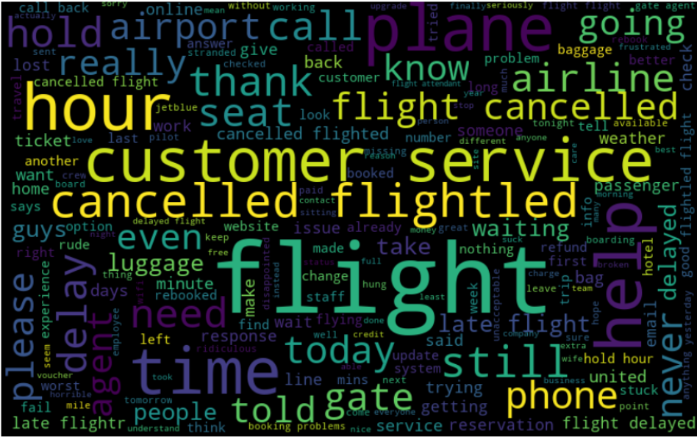
WordCloud Negative Sentiment

Slide 19
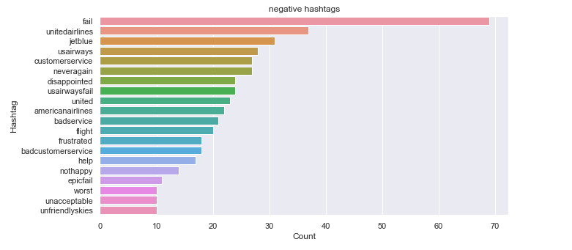
Understanding the impact of Hashtags on tweets sentiment

Slide 20
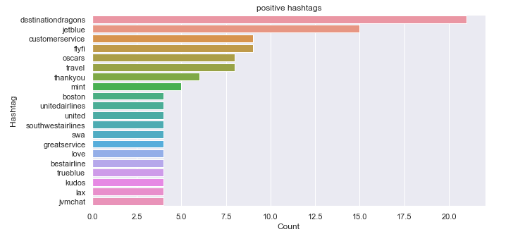
Understanding the impact of Hashtags on tweets sentiment

Slide 21
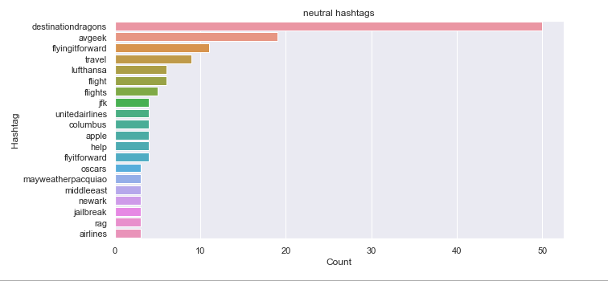
Understanding the impact of Hashtags on tweets sentiment

Slide 22
Word Embeddings
A word embedding is a learned representation for text where words that have the same meaning have a similar representation.
Bag of Words
TF – IDF
Word2Vec
In contrast with One-Hot-Encoding, where each variable is independent

Slide 23
Apply Classic Machine Learning Algorithms
Used only ‘text’ processed column
Applied all the Algorithms we were taught during the semester
Made time and accuracy comparisons
Used all 3 word embedding techniques

Slide 24
Predictions
Bag of words
Tf - idf
Method | Accuracy(%) | Time(sec)
Logistic Regression | 76.3 | 0.73
SVM | 76.8 | 6.5
KNN | 60.8 | 0.003
Random Forest | 73 | 7.5
Decision Tree | 66.8 | 0.7
Naïve Bayes | 39.9 | 0.28
Gradient Boosting | 71.2 | 2.8
Method | Accuracy(%) | Time(sec)
Logistic Regression | 76.5 | 0.46
SVM | 76.8 | 5.72
KNN | 51.9 | 0.001
Random Forest | 73.1 | 6.94
Decision Tree | 69.2 | 1.18
Naïve Bayes | 37.6 | 0.26
Gradient Boosting | 73.6 | 8.08

Slide 25
Predictions
Word2vec
Method | Accuracy(%) | Time(sec)
Logistic Regression | 78 | 2.24
SVM | 78.2 | 27.21
KNN | 73.4 | 0.17
Random Forest | 73.7 | 20.54
Decision Tree | 63.4 | 6.53
Naïve Bayes | 70 | 0.064
Gradient Boosting | 75.9 | 122.84

Slide 26
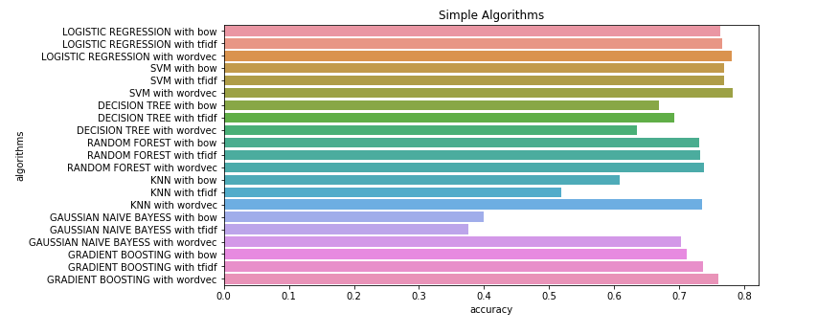
Predictions

Slide 27
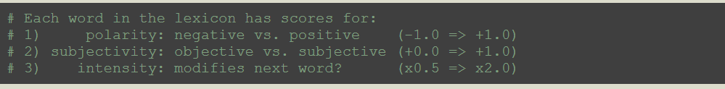
Text to sentiment attribute using TextBlob (entire dataset)
The TextBlob package for Python is a convenient way to do a lot of Natural Language Processing (NLP) tasks
We swap ‘text’ column with ‘sentiment’ column

Slide 28
Predictions – textBlob
With sentiment
Without sentiment
Method | Accuracy(%) | Time(sec)
Logistic Regression | 84.2 | 0.73
SVM | 88.8 | 37.8
KNN | 85.7 | 0.12
Random Forest | 88.9 | 0.42
Decision Tree | 88.9 | 0.01
Naïve Bayes | 88 | 0.008
Gradient Boosting | 89.8 | 2.9
Method | Accuracy(%) | Time(sec)
Logistic Regression | 76.3 Simple | 0.26
SVM | 84.2 | 0.49
KNN | 83.4 | 0.14
Random Forest | 83.4 | 0.3
Decision Tree | 84 | 0.01
Naïve Bayes | 82.9 | 0.006
Gradient Boosting | 83.2 | 2.18

Slide 29
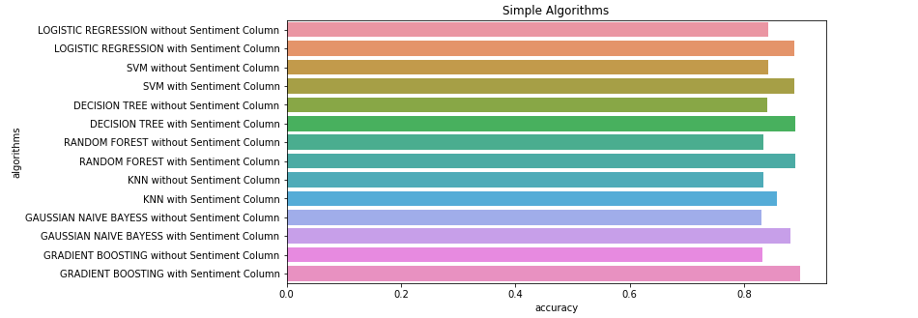
Visualization – textBlob

Slide 30
Neural Networks
More… complicated and time consuming
Used the entire dataset except:
In LSTM network, we used only the ‘text’ column as input

Slide 31
Sentiment Analysis with Keras (Neural Networks)
Keras with Tensorflow backend models created and trained:
Simple Keras Classifier
Split train
10-folds evaluation
Convolutional NN
Simple NN with embedding layer
Simple NN with 2 hidden layers – GRID search
LSTM only for negative/positive sentiment

Slide 32
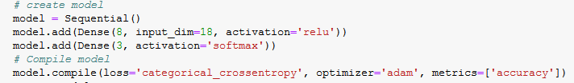
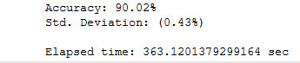
Simple Keras classifer
10 epochs
10-folds evaluation:

Slide 33
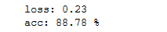
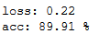
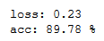
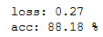
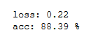
Train/Test split (67-33) with multiple optimizers:
Adam:
SGD:
RMSprop:
Adagrad:
Nadam:
Just changing the optimizer, isn’t enough. One must play with its parameters to maximize accuracy

Slide 34
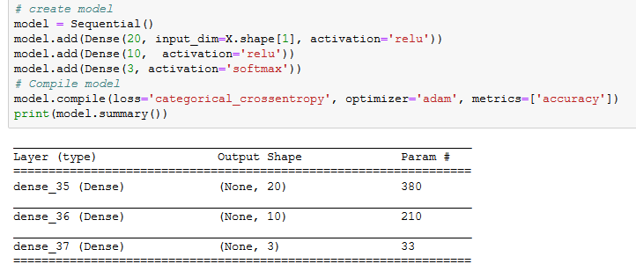
Simple NN with 2 hidden layers – GRID search
Used textBlob for ‘sentiment’ extraction
Swapped ‘text’ with the new ‘sentiment’ column

Slide 35
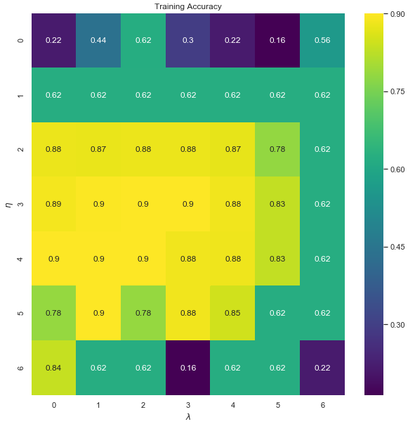
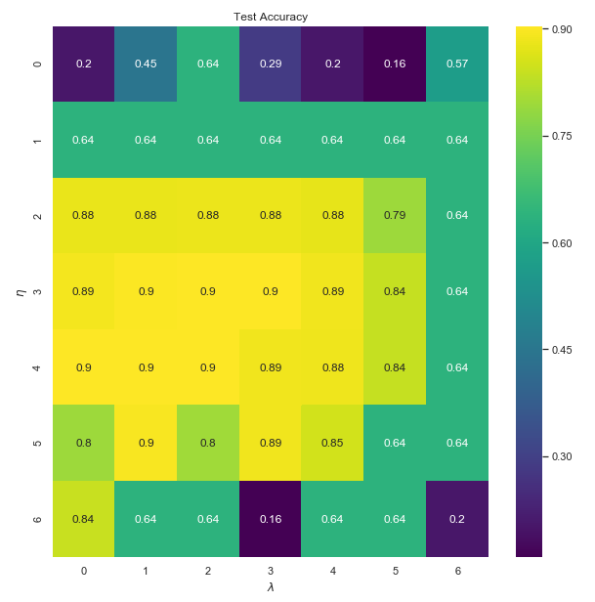
GRID results visualization
n : learning rate λ : regularization term
0 = 10^(-5) ~ 6 = 10

Slide 36
Tokenization
The following NNs use Embedding Layer, which requires a specific input format.
Our tokenization process is based on TF-IDF embedding method and creates that specific format.
Every text is represented by a vector now.
Sequence padding to make each vector of same size (fill with zeros)

Slide 37
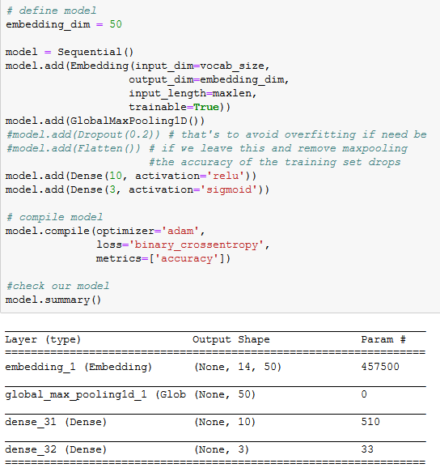
Simple NN with embedding layer

Slide 38
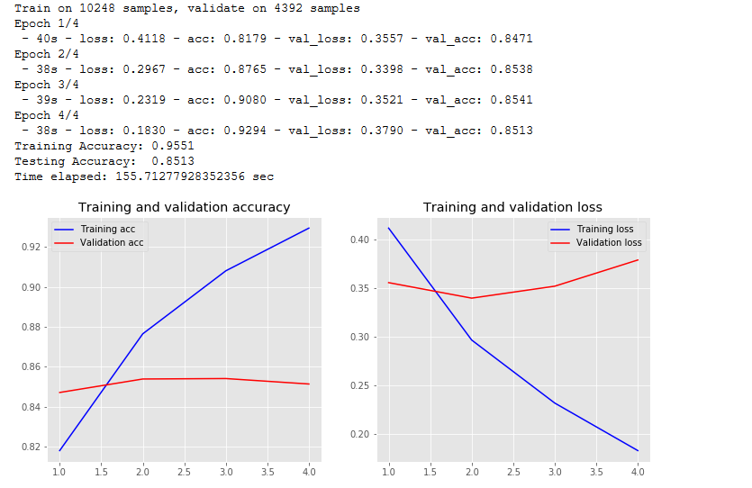
Simple NN with embedding layer

Slide 39
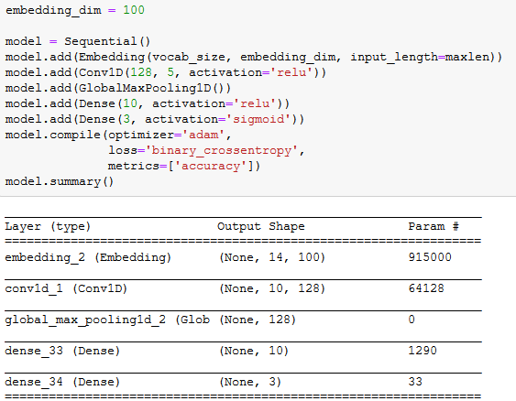
CNN

Slide 40
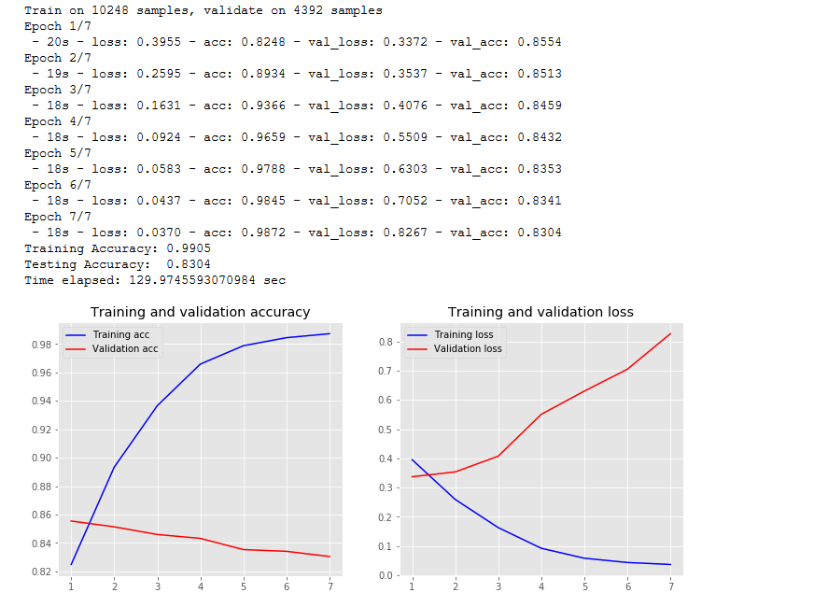
CNN

Slide 41
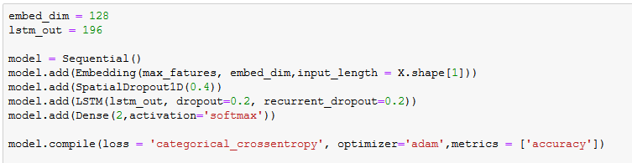
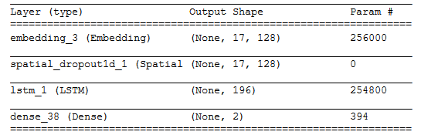
LSTM only for negative/positive sentiment

Slide 42
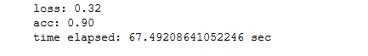
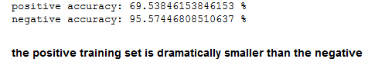
LSTM only for negative/positive sentiment
Results:
Results on positive/negative seperately:

Slide 43
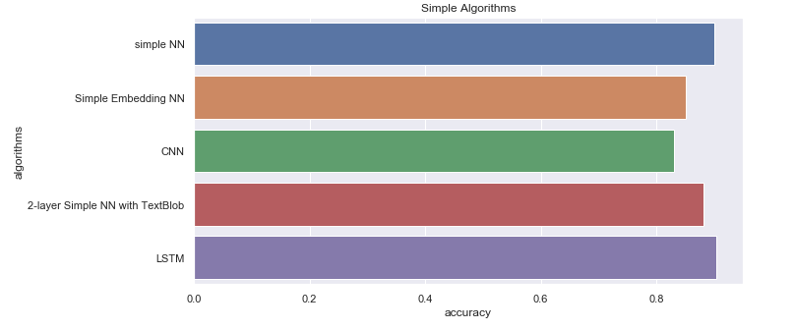
Comparison of NNs’ accuracy

Slide 44
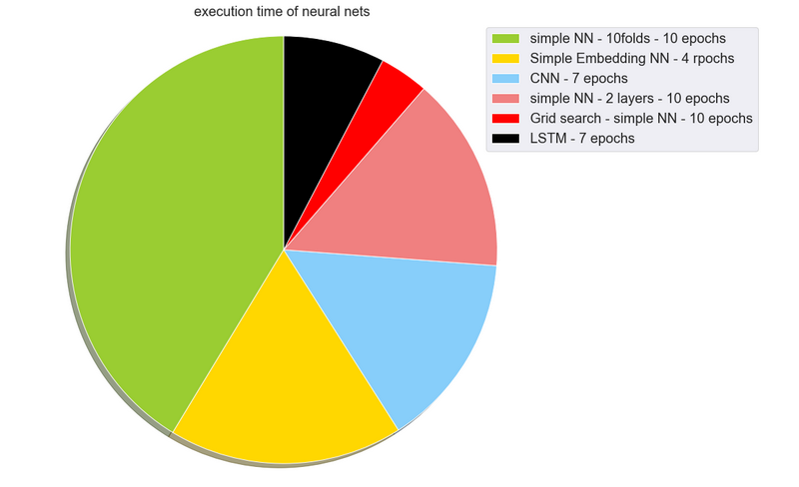
Comparison of NNs’ execution times

Slide 45
Conclusions
Best accuracy:
Classic ML algorithms: Gradient Boosting on entire dataset with textBlob – 89.8%
NNs:
LSTM – 90% (no neutral class)
simple Keras classifier – 90.02%
GRID search also achieved 90% with several different combinations of n,λ
NLP is a very important process
When a dataset’s labeling is not balanced (0’s much more than 1’s etc) we will observe better accuracy on the favored class
Neural Networks seem to work better on sentiment prediction, but are way more costly
We must be very careful to avoid overfitting, especially in CNNs

Slide 46
Conclusions
General accuracy is not always enough. A company might be more interested in categorizing the negative sentiment class.
If we downloaded live data from twitter, it would be an interesting unsupervised clustering problem

